Slide 1
Maps
Computer science 3

Slide 2
Map
Sub
Interfaces
-extends
Collections
Collection
Implementing
Classes
SortedMap
Sub
Interfaces
-extends
HashMap
HashTable
Implementing
Classes
List Set
Sub
Interfaces
-extends
Implementing
Classes
TreeMap
SortedSet
Implementing
Classes
ArrayList
LinkedList
Vector
TreeSet
AbstractSet
HashSet
LinkedHashSet

Slide 3
Java Map Class
The Map interface does not extend any
other interface.
Map
HashMap
SortedMap
TreeMap

Slide 4
Java Map Class
A Map stores pairs of keys and values.
Each key – value pair is unique.
A translation program could be
written using a map.
Maps cannot store duplicates.

Slide 5
Java Map Class
Key | Value
restroom | bano
cat | gato
boy | muchacho
house | casa
toad | sapo
water | agua

Slide 6
Java Map Class
Because Map is an interface, you cannot instantiate it.
Map bad = new Map(); //illegal
Map hash = new HashMap(); //legal
Map tree = new TreeMap(); //legal
hash and tree store Object references

Slide 7
Java Map Class
You can specify which type of references you want to
store in the TreeMap or HashMap.
Map<String, Integer> hash;
hash = new HashMap<String, Integer>();
Map<String, Set> tree;
tree = new TreeMap<String, TreeSet<String>>();

Slide 8
Java Map Class
HashSet and HashMap were both
created around hash tables.
A hash table is a giant array. Each
item is inserted into the array
according to a hash formula.
0 1 2 3 4

Slide 9
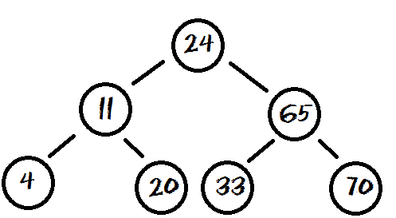
Java Map Class
TreeSet and TreeMap were built around balanced binary trees.
A Binary Tree is a group of nodes that contain left and right references. Each item is inserted into the tree according to its relationship to the other nodes.

Slide 10
Map Methods
Map frequently used methods
Name | Use
put(x,y) | adds the <x,y> pair to the map
get(x) | gets the value for key x
clear() | removes all items from the set
size() | returns the # of items in the set
keySet() | returns a set of all keys in the map
containsKey(x) | checks if key x is in the map

